Slide 1

Go Snackin'
By Elliot, Shravya, Mira, Deshani, Stephen, Taric & Jordan

Slide 2
Project Overview
With the arrival of the new technological era of AI, the navigational apps we rely on have been left in the dust.
Why does Google Maps still need extensive user input to plan routes for you?
Go Snackin' aims to bring the power of natural language input and AI recommendations to modernise the apps we rely on every day.

Slide 3
Task Allocation & Collaboration
Member | Role
Elliot | Back-End
Shravya | Front-End
Mira | Business Plan, AI Training
Deshani | Business Plan
Stephen | Design
Taric | Design
Jordan | Documentation and Business Strategy
Kyle | Mentor
Main platforms of communication and cooperation between team members were WeChat and file repository for code and documents.
Morning and evening meetings were conducted for assignment of tasks and daily checkpoints, both of which allowed for cohesive and effective progression.
During initial project plan, each member's strengths were discussed to ensure the most appropriate allocation of skills.
Notes:
1. mention discussion of each individual's strengths

Slide 4
User Stories
As a user, I want to plan a
route with
natural language.
As a user, I want a food
location to be suggested
based on my preferences.
As a user, I want a place
recommended to me
during my trip.
As a food business owner,
I would like to
promote my business for
higher visibility.
As a user, I want to plan
my route
using voice language.

Slide 5
Business Plan
Valuable user data can be generated and sold - information such as user food preferences and navigational activity is of interest to many organisations.
Businesses can start paid campaigns to favour their stores over ones in similar categories when directing users around.

Slide 6
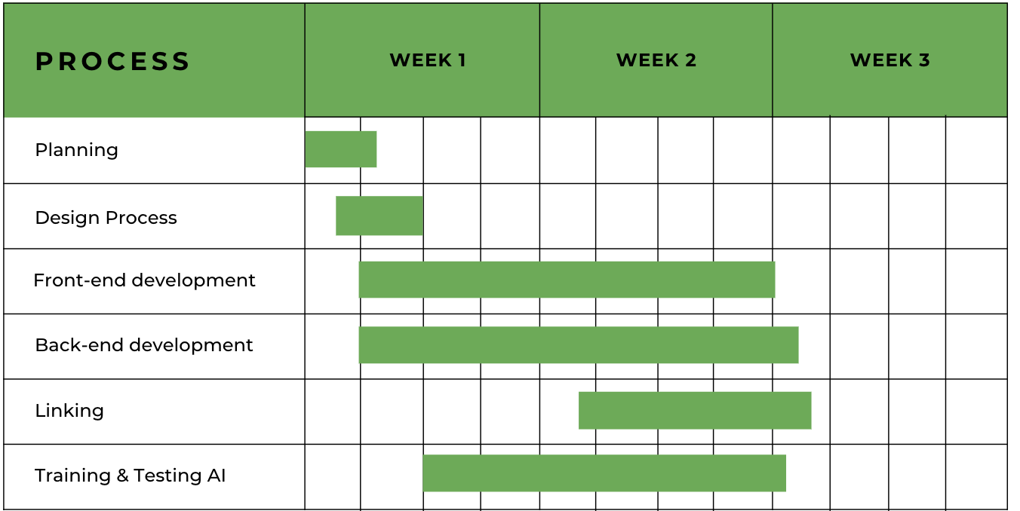
Gantt Chart
Gantt Chart

Slide 7
Risks
01
02
03
Currently our web application relies heavily on the response provided by the Google API. As such, any changes to the API may have significant impact to the project. The cost of API calls may also become prohibitive to scaling.
Similarly, our natural language processing it built on a system designed by Meta that further makes our business heavily dependent on other projects. We may work to develop in-house models in the future.
Although our idea is new, the speed of current progress in AI products may mean an advantaged competitor emerges before the business has time to scale.

Slide 8
Current Features
Users:
Sign up
Log in (Remember me functionality)
Preference selection for new users
Route Planning:
Natural language input can identify places and a small number of activities
Place input is corrected into valid addresses, a route is planned that includes a stop
at an appropriate place (cafe, fast food place etc.)

Slide 9
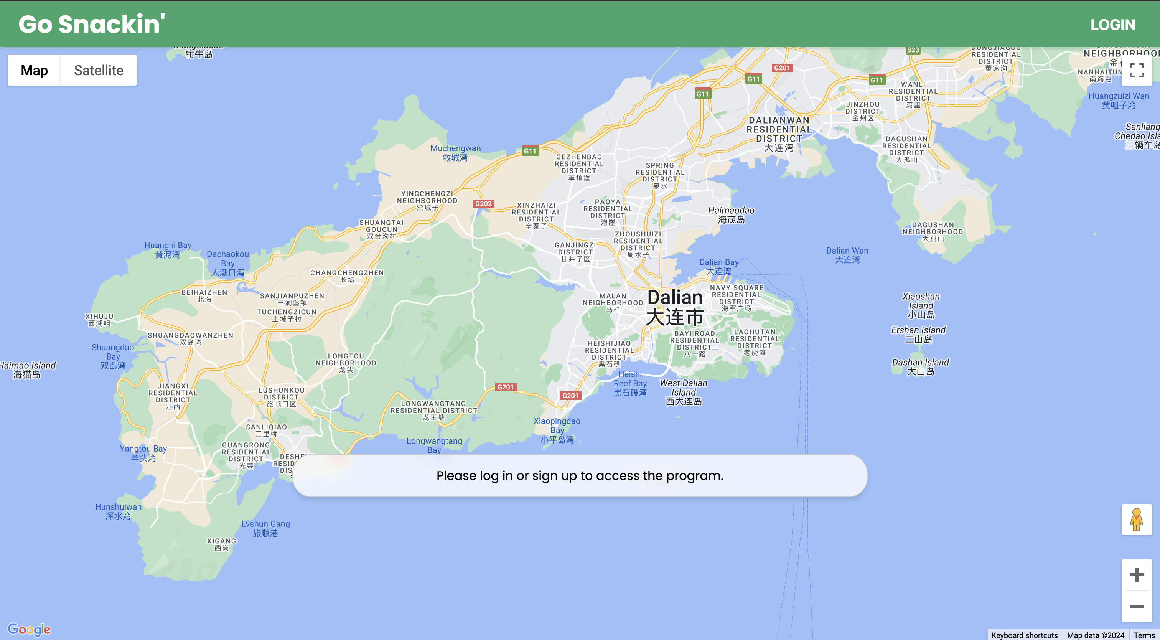
Home Screen For Guests

Slide 10
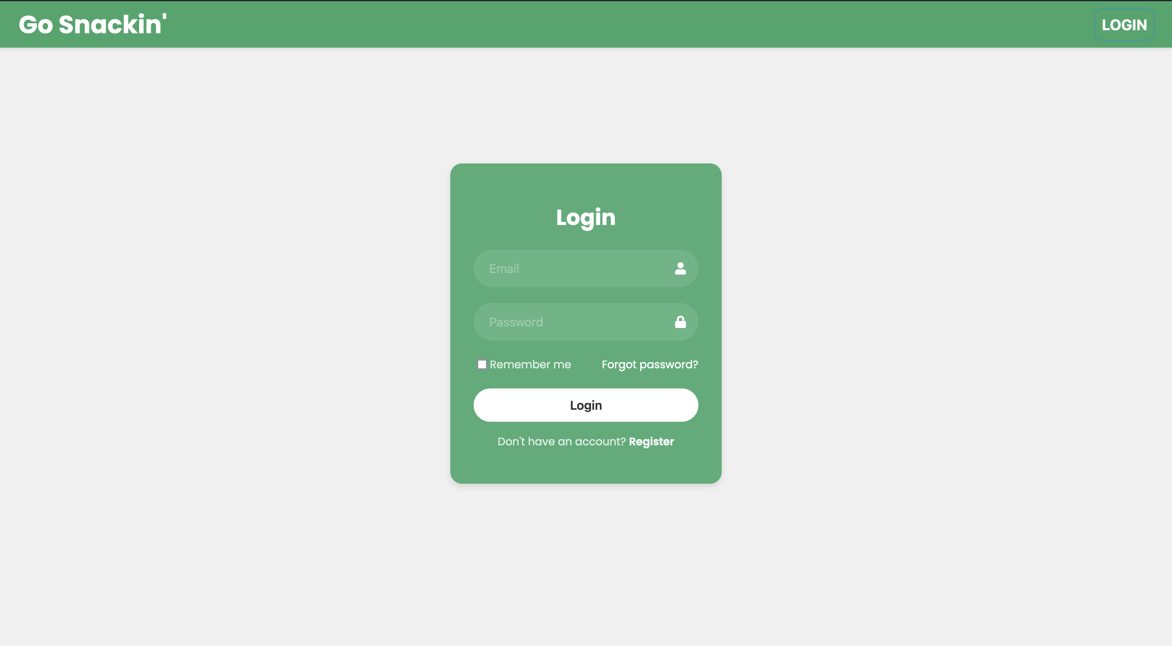
Log In Screen

Slide 11
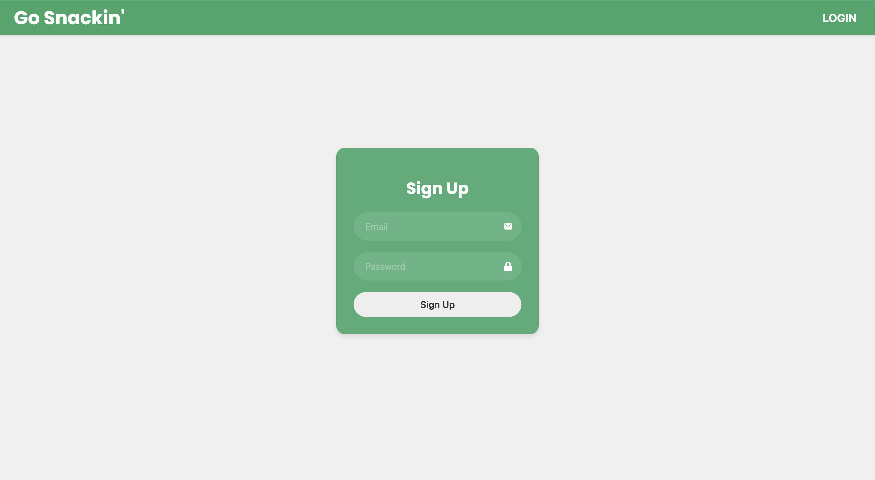
Sign Up

Slide 12
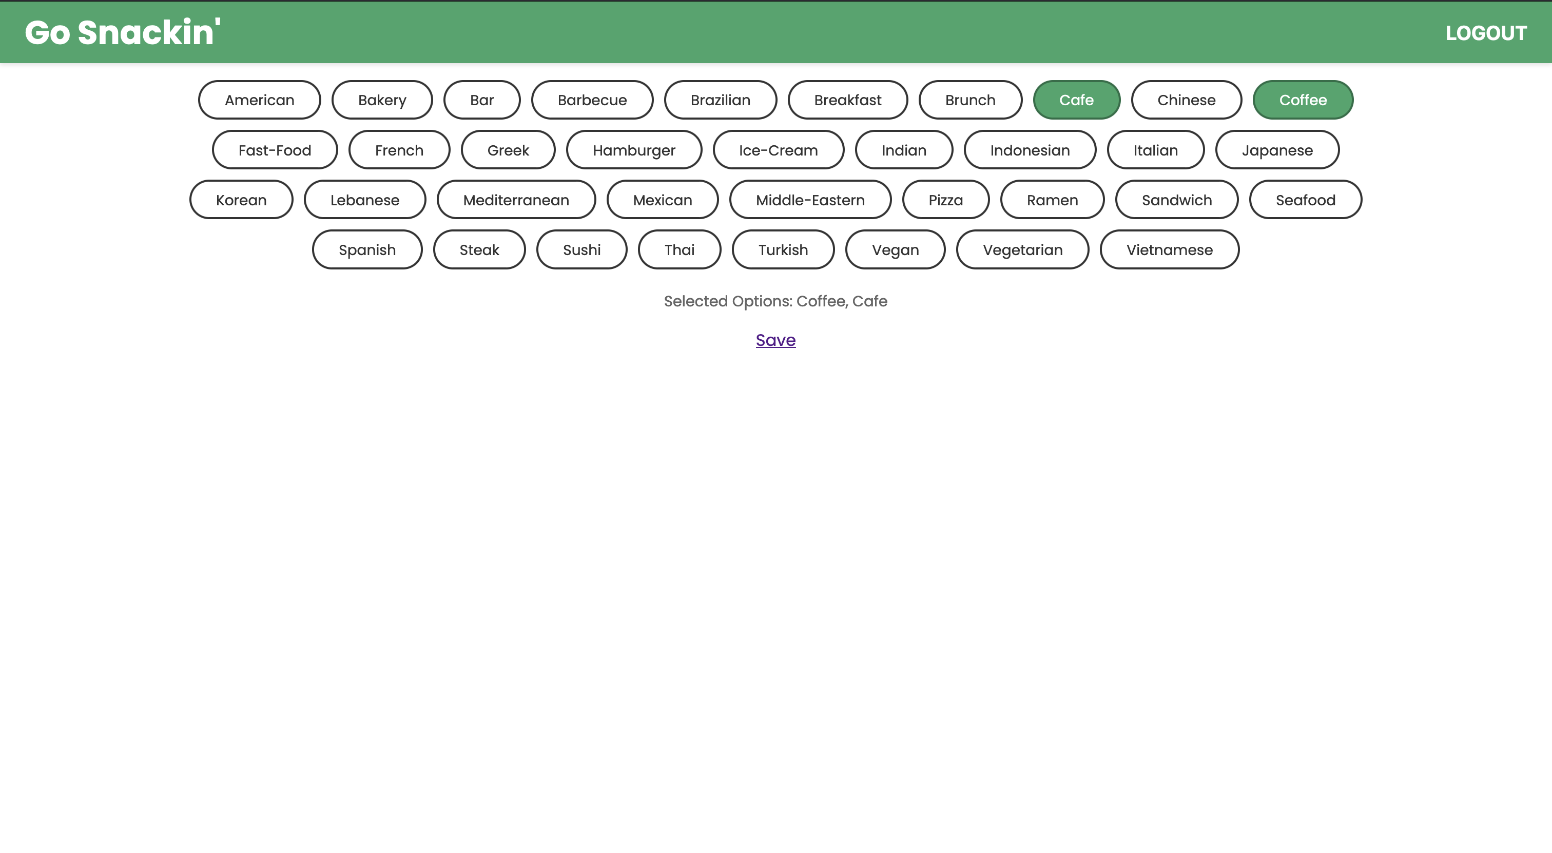
Preference Screen

Slide 13
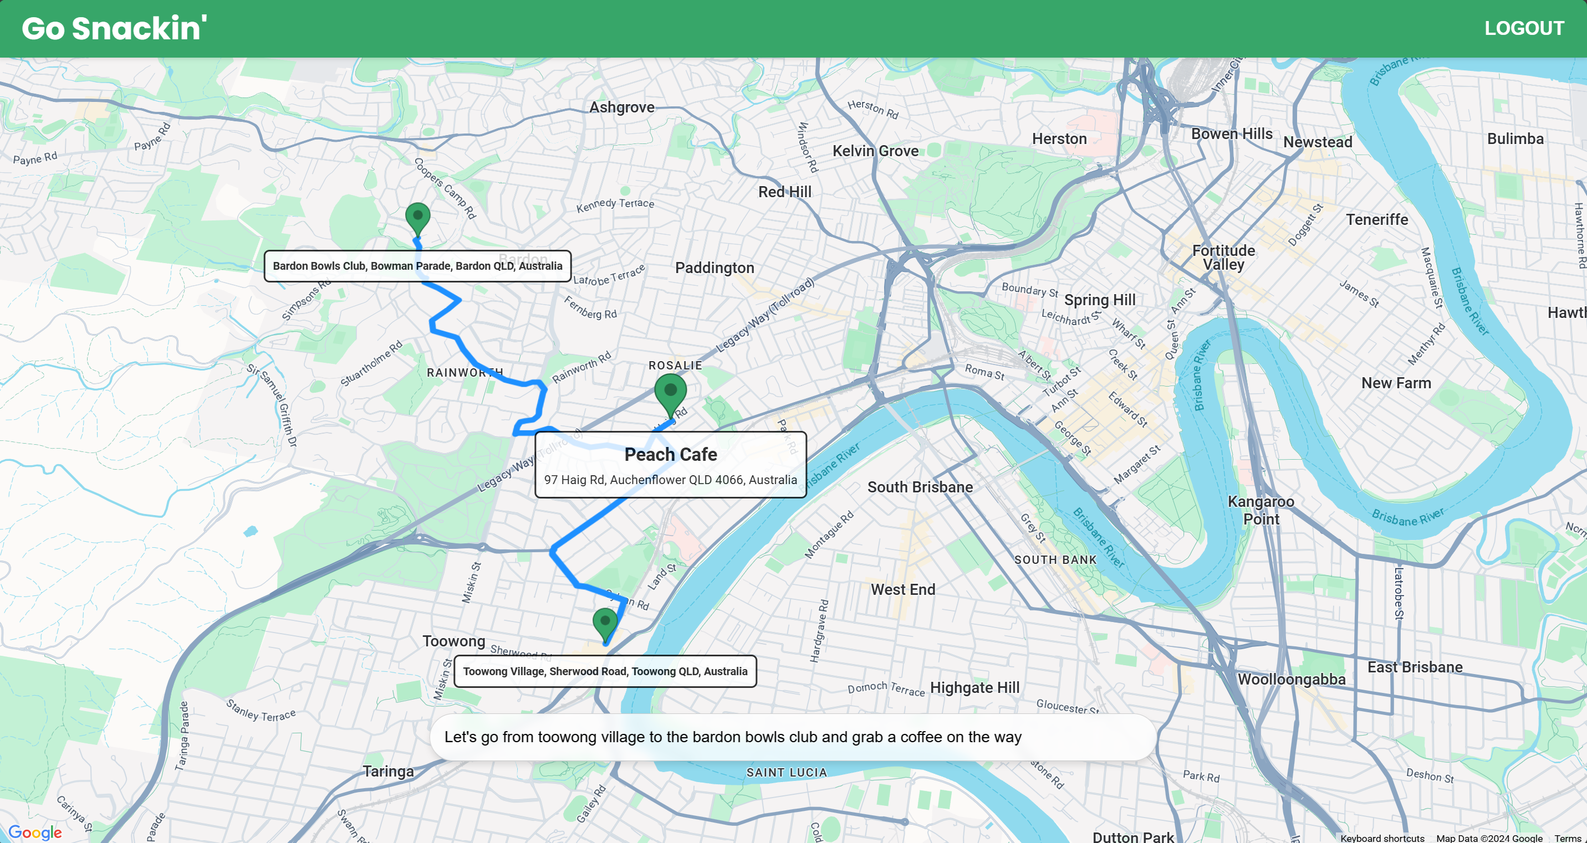
Route Planner

Slide 14
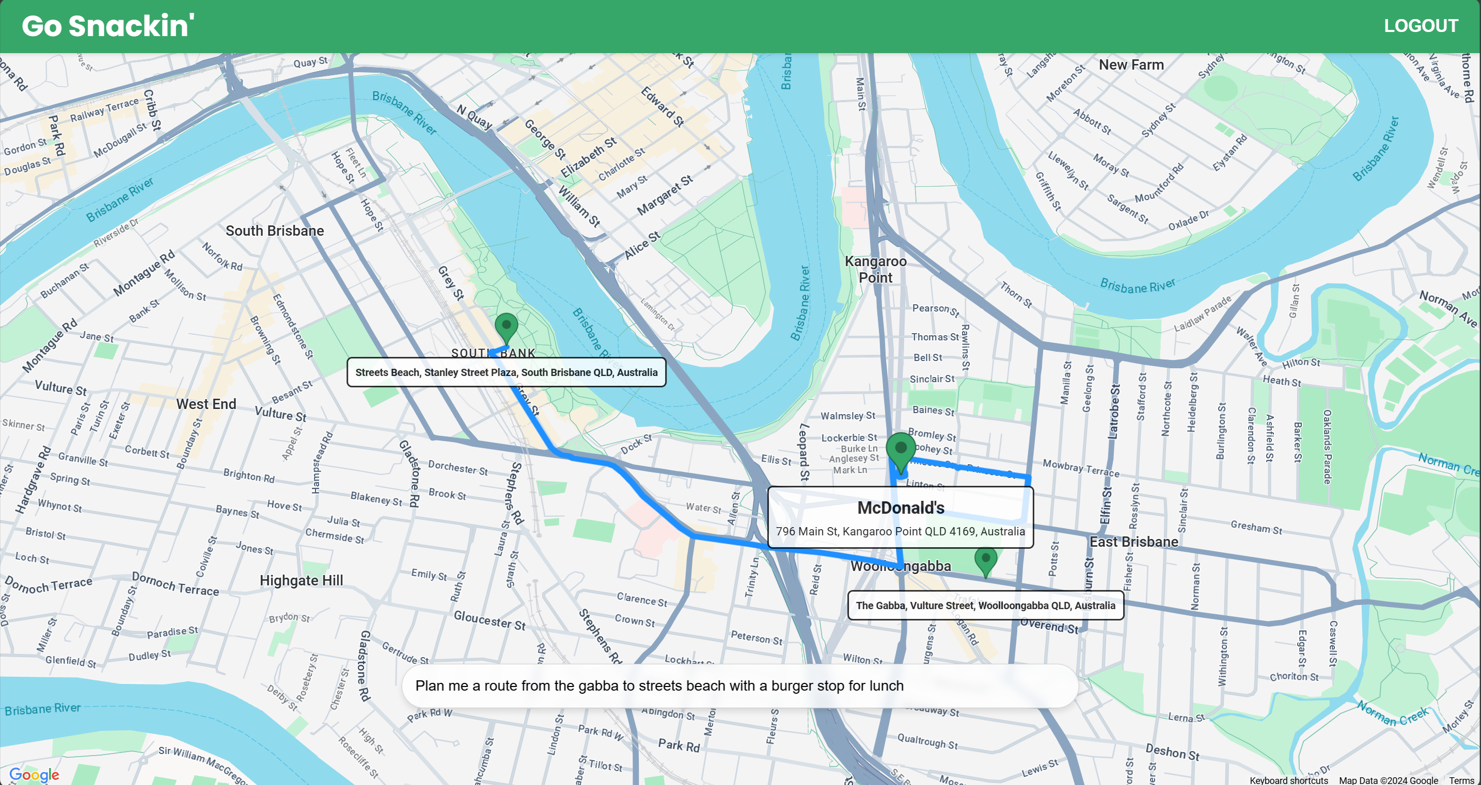
Route Planner

Slide 15
Future Implementations
Users:
Forgot password
Route:
Improve recommendations to be catered to the user's preferences
More complex route types - multiple stops, different modes of transport
Usability
Natural language voice input

